Slide 1

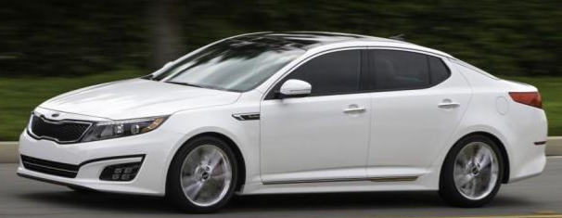
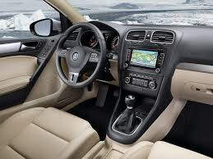
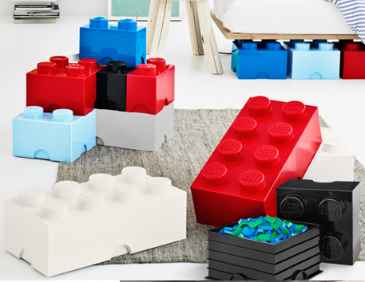
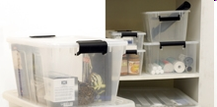
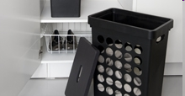

See
Our
Possibilities …
Notes:
1

Slide 2
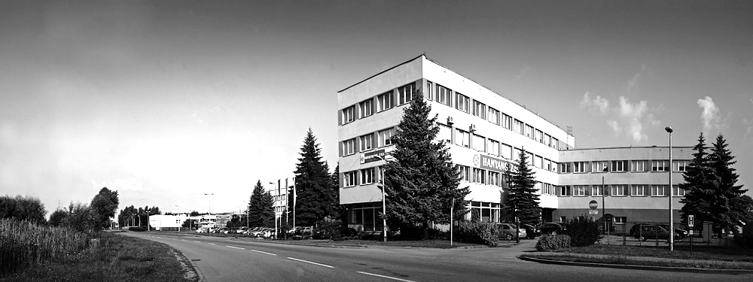
About us
Mission
Production high quality products fulfilling the Clients
expectations accompanied with the following rules:
On time deliveries
Cost reduction
Environment friendly
General information
Start 1972
Location Elbląg, Warszawska 72 St.
Capital 8 789 mln €
Employment 200 person
Production area 12 829 m²
Average annual sale 11 mln €

Slide 3

THE HISTORY
METAL
STYREN
1972 – Establishment of ZAS Company
by merger of two companies:
ZTS Styren and Metal.
FSO
Warsaw
ZAS
Inclusion ZAS to FSO Company
in Warsaw.
Daewoo
ZAS
1996 – ZAS Transformation into a partnership
with the Korean Concern Daewoo.
HANYANG
Precision
HANYANG ZAS
Sp. z o.o.
1997 – Conclusion of agreement
with HANYANG Precision –
establishment of the HANYANG ZAS
Company.
Daewoo withdrew its shares
2011 – HANYANG Precision has transfered
the ownership of shares to H&D,
both operating within the same
capital group.
FSO
Warsaw
HANYANG ZAS
Sp. z o.o.
90% FSO S.A.
10% H&D Co.

Slide 4
Highlights of the Company
1972 – FSO – establishment of Zakład Armatury Samochodowej (ZTS STYREN and Spółdzielnia METAL)
1972 – 1996 – FSO – Fiat, Polonez
1996 – FSO conversion – from state-owned enterprise into Daewoo Korean company
1997 – Hanyang ZAS – signing a contract with the Korean company HANYANG Precision
1996 – 2007 – Daewoo FSO - Polonez Plus, Matiz, Nubira, Lanos
1998 – ISO 9001 certificate
1999 – 2006/ 2009-2011 – IKEA – Rationell, Risten, Leckmann
2004 – ISO/TS certificate
2003 – 2004 – company restructuring
2004 – 2012 – Rosti – Philips, Napoleon, TUNA, senseo, tank lid, base plate, filter
2005 – ZAO ZAZ Ukraine – acquisition of FSO shares
2005 – 2011 Thule - Suzuki, Fiat, Ford
2008 – 2011 Adam Opel – Astra 2
2008 – 2011 Project GM DAT - Chevrolet Aveo
2009 – Plast Team – expanding the cooperation – products for household goods market
2010 – Plast Team – Lego storage boxes
2011 – SMR - Opel Astra 4 (3HB and Cabrio)
2011 – Sapa - project NBC (Suzuki, Fiat), B90 Dacia Cross
2013 – ROOM COPENHAGEN – Lego storage boxes
2014 – Daedong Poland – KIA and Hyundai
2014 – BS Systems – L-Boxx Mini
Notes:
4

Slide 5
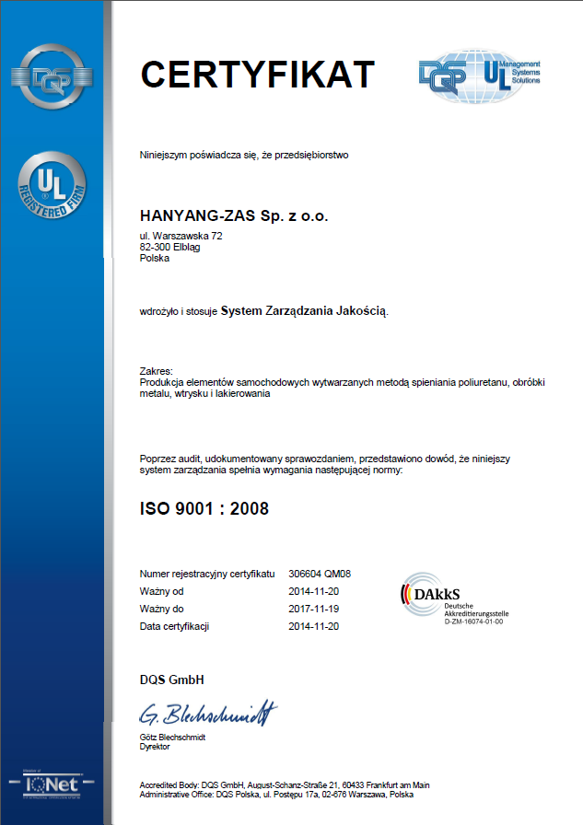
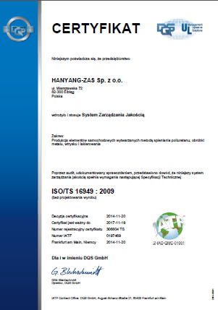
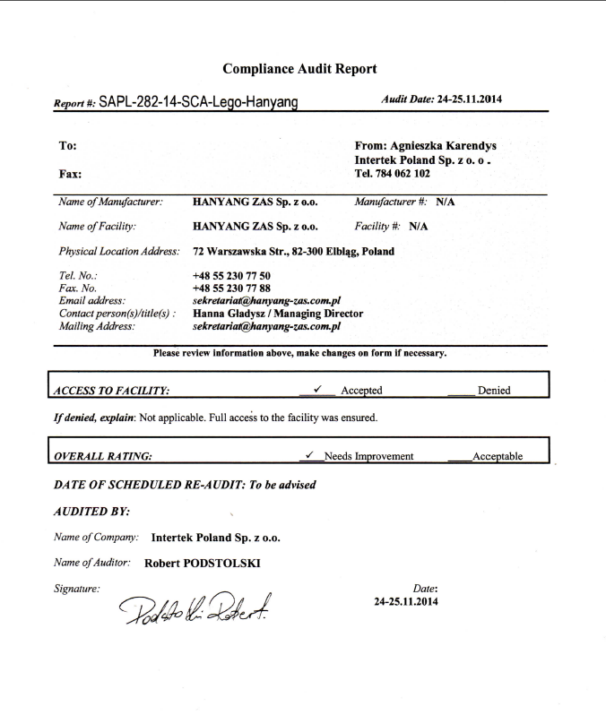
Certificates and audits reports
Notes:
5

Slide 6
Organization chart
Average employment:
200 employees
PZ | President of Board
Board
DZ | Managing Director
PIM | Engineering and Marketing
PM | Maintenance Group
ZO | Organization and Managing
ZI | Information Technology
ZK | Personnel Department
ZZ | Purchasing Group
ZS | Sales and Warehouses Group
ZF | Financial Department
PO | Planning and Control of Production Process
PP | Production Department
Injection moulding machines
Painting shop
Assembly
PN | Tool Shop Group
Accounting
Wages
PJ | Quality Assurance Group
POB | Environment protection and Work safety

Slide 7

Lay-out
Production area
12 829 m²
Stock rooms
3 490 m²
Tool shop
870 m²
Injection machines
5 760 m²
48 injection moulding machines
Metalworking
880 m²
Paint
shop
1 350 m²
Assembly shop
PU foaming
479 m²
Preparation for
paint shop
Office
Entrance

Slide 8
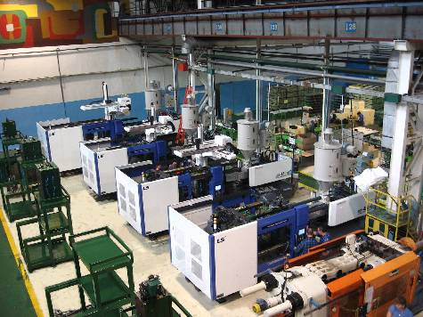
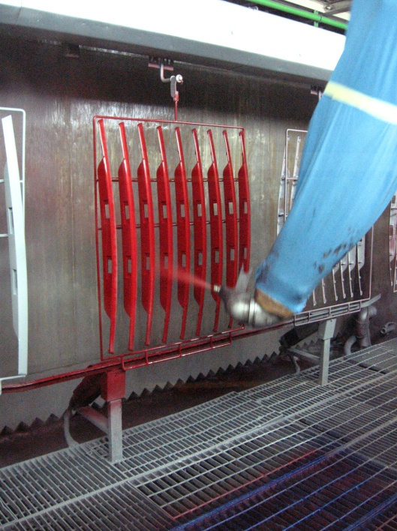
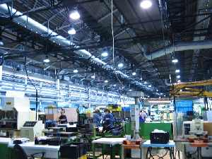
Technologies
and methods of production
Injection
Painting
Assembly

Slide 9
Production technologies - information
Injection
Painting
Assembling
48 injection machines with clamping force from
75t into 1300t
2K injection technology
technology IML – 4 stands
Hot stamping technology
injection technology with the gas filling
technonology for high speed injection with turbo
automated position equipped with robots, conveyors, masterbatch loaders
central automatic supply system of raw material
average monthly amount of material processed about 300 tons of PP
maximum weight of injected detail - 5,5 kg
automatic painting line
painting in three layer system
line equipped with:
3 FANUC robots with six axes
automatic paint supply system
semi - automatic painting line
painting in two layer system
equipped with two manipulatores
tampoprint
assembly lines
ultrasonic welder
vibrating welder - Branson
hot plate welder
resistive welding
mounting presses

Slide 10
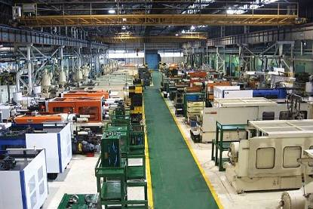
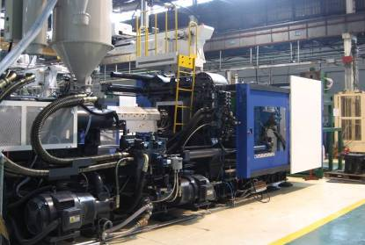
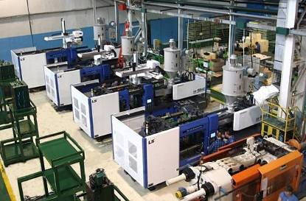
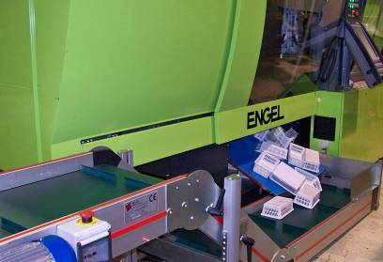
Machinery
Notes:
10

Slide 11
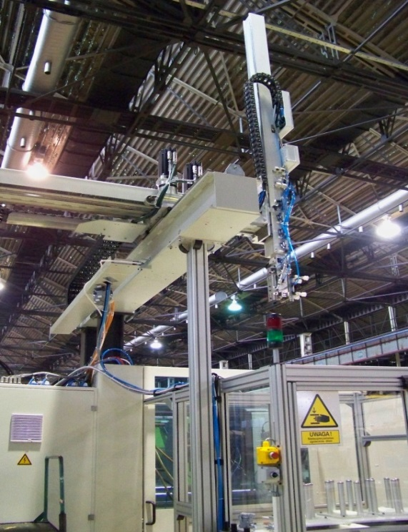
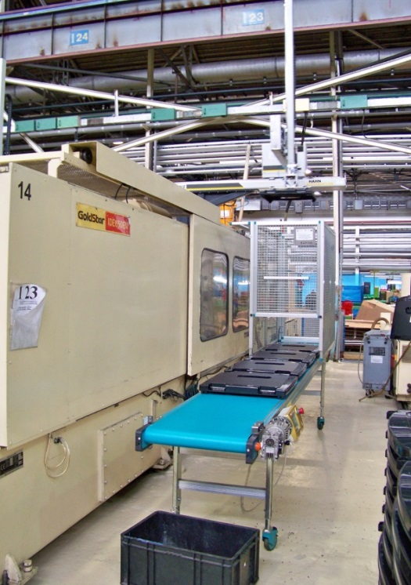
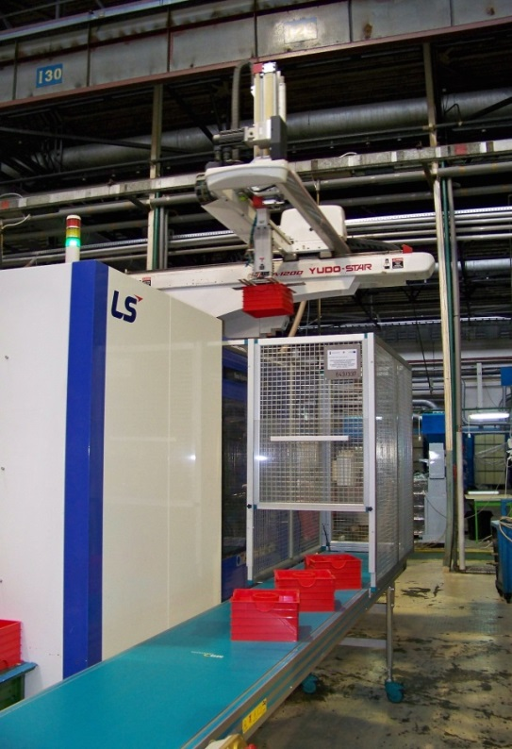
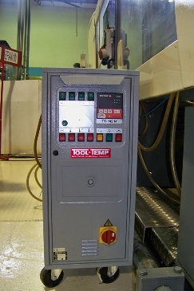
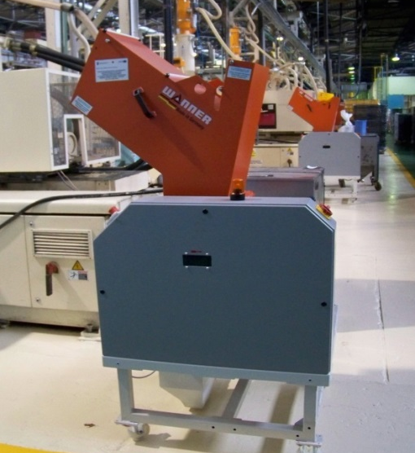
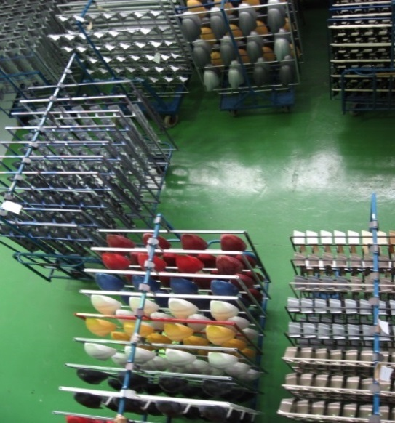
Machinery

Slide 12
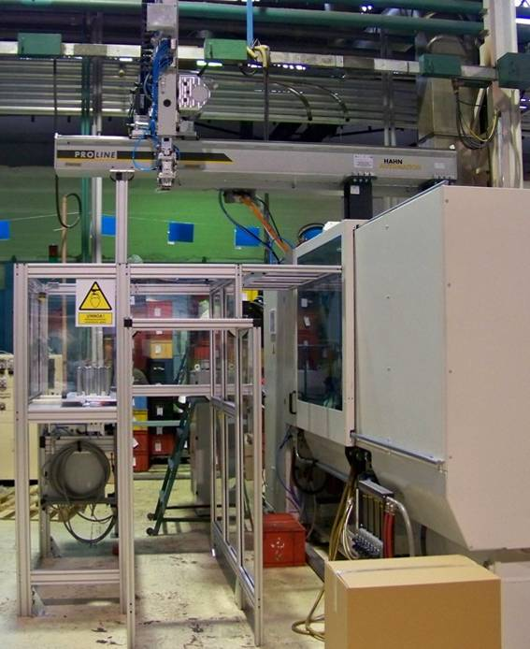
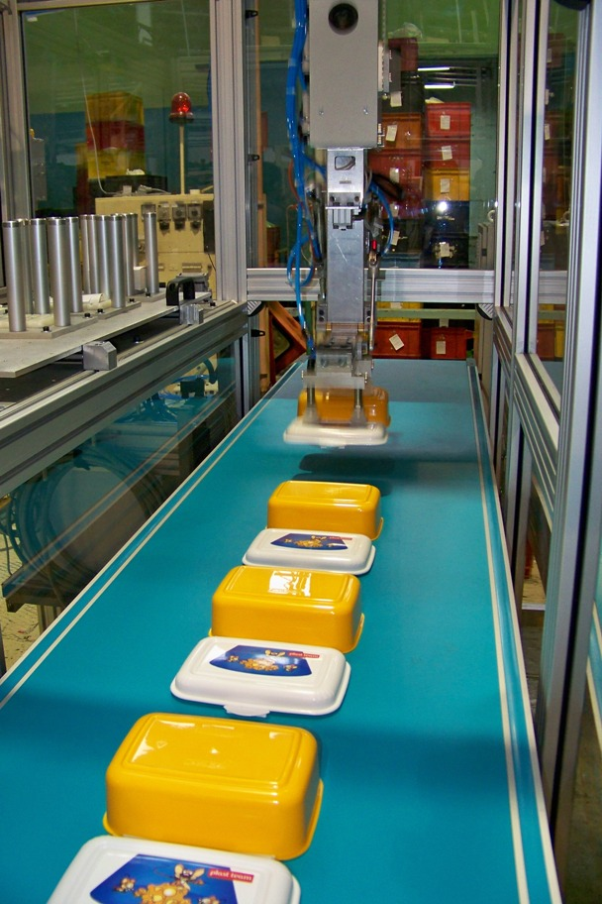
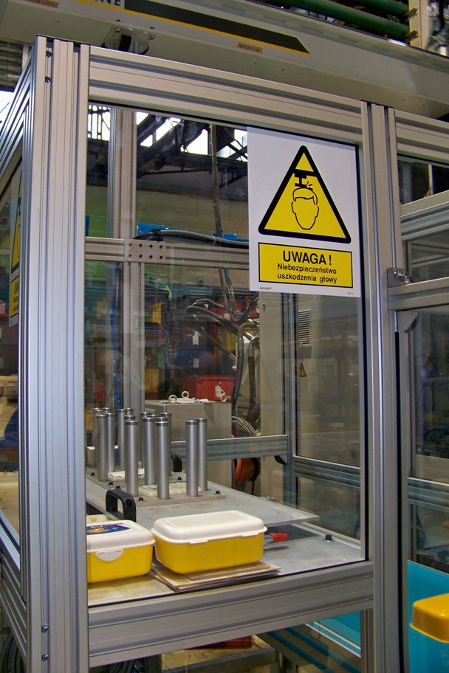
IML technology
2K – two components - Battenfeld machine HMMR 300/225OH/3505

Slide 13
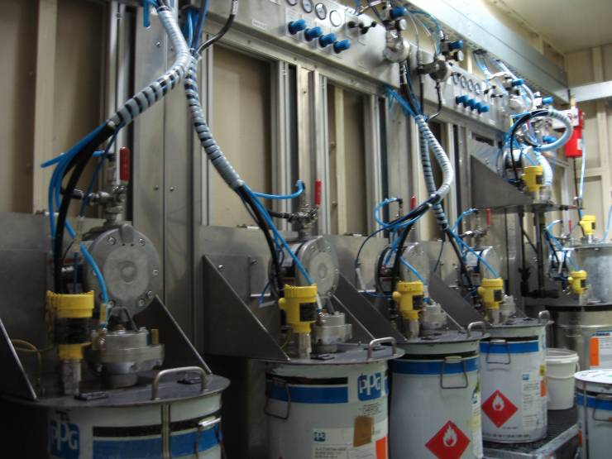
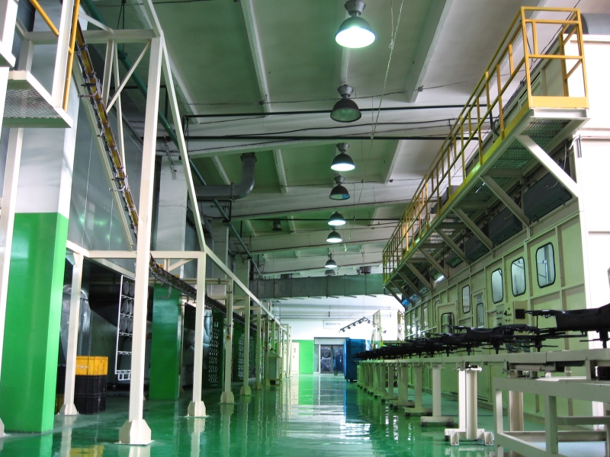
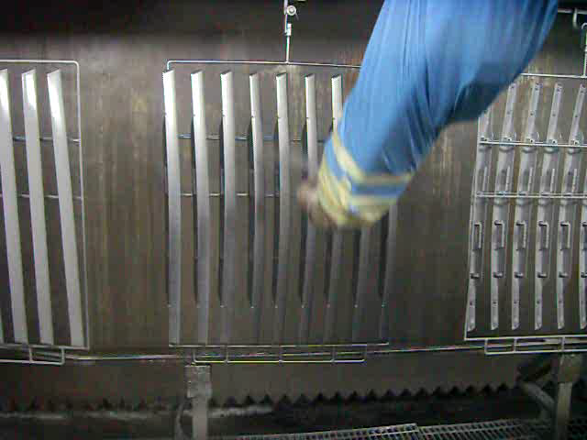
Paint shop
Line A
3 FANUC robots with six axes
automatic paint supply system
Line B
equipped with 2 manipulatores
Additionally
Spectrophotometer defining colours
Possibilities:
- three-layer paint application:
primer, basecoat, clearcoat
soft touch, high gloss, etc.
Notes:
13

Slide 14
























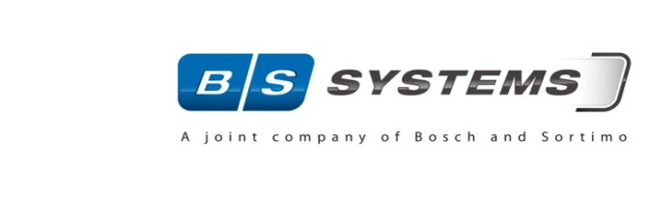

Companies which have trusted us
Automotive
Household Goods
Toy industry
The official LEGO licence
Technical projects
Notes:
14

Slide 15
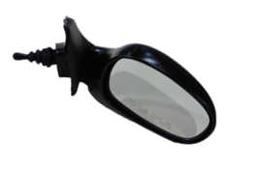
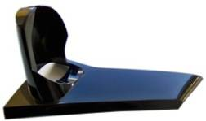
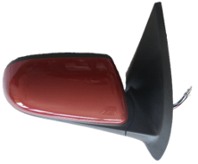
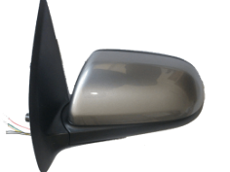
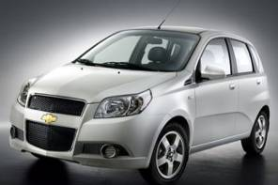
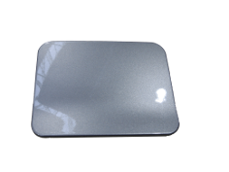
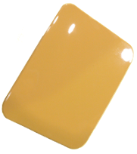
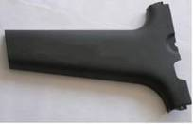

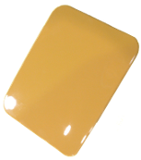
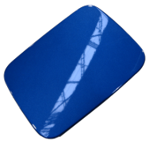

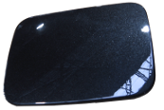
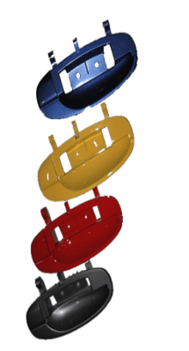
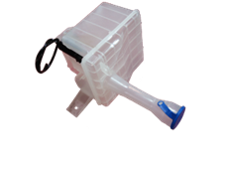
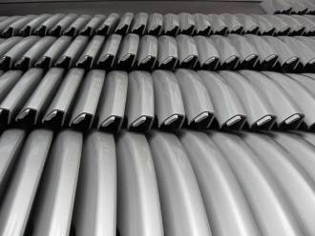
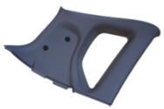

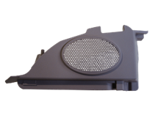
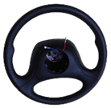
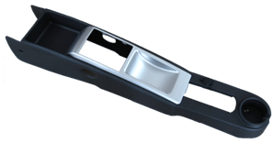
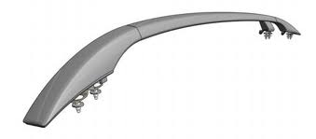
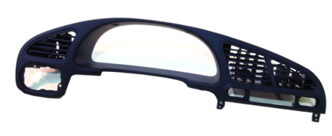
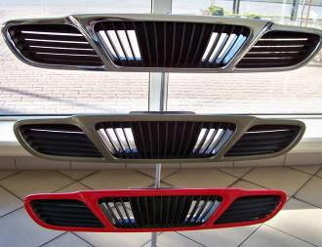









Production possibilities
Totally: 120 products
Automotive
Notes:
15

Slide 16













GM Daewoo Auto & Technology
The largest launched project
CHEVROLET AVEO
130 manufactured parts

Slide 17






Other launched projects
Mirror bracket for Opel Astra 4 (3 HB & Cabrio)
Injection and painting caps, profiles, foots for:
Ford, Dacia, Suzuki, Fiat
Exterior mirrors for Daewoo Lanos and VIDA
Injection, painting and assembly of the parts for projects:
Kia YN, Facia Panel, Panel Hundai GDe
Injection and painting of 6 parts for Volkswagen
and Suzuki Project
Notes:
17

Slide 18







Other launched
Bucket, tray with IML, Helsinki Project
Painted details
Strong pad
L-Boxx MINI
Notes:
18

Slide 19



























Examples of Household Goods and Technical projects
Notes:
19

Slide 20

















Production possibilities
Totally: 17 products

Slide 21

Our products are available in…
Notes:
21

Slide 22
Sale structure in thousands €
Notes:
22

Slide 23







Quality Department measure capabilities
testing of materials and finished products
SPC
Spectrophotometer
3D scaner
Carl-Zeiss Prismo Coordinate Measuring Machines (CMM)

Slide 24

Internal Facilities for Quality Tests
Material test
Products test
rockwell hardness
flexural strength and modus
flammability
impact strength – IZOD
melt flow index
melting point
heat deflection temperature
density
tensile strength
elongation
softening temperature according to Vicat
filler content
Rockwell hardness
flexural strength and modus
flammability
impact strength – IZOD
melt flow index
melting point
heat deflection temperature
density
tensile strength
elongation
softening temperature according to Vicat
filler content
resistance to temperature cycling
resistance to high humidity
spectrophotometric color measurement
resistance to cleaners
resistance to colour change
abrasion resistance
resistance to Sulphur Dioxide staining
fuel resistance
perspiration resistance
impact strenght
temperature stability
scratch resistance
satisfactory operation
resistance to heat aging
chemical resistance

Slide 25



Tool Shop
Our tool shop provides comprehensive care to the entrusted tools and moulds.
Possibilities and experience
Thanks to the software (CAD) Solid Edge (CAM) CAM SPRUT and skiled engineering staff, we provide ongoing maintenance and regeneration of tools
SUPERVISION SOFTWARE TOOL supports the management
of the timely regeneration and maintenance of tools.

Slide 26



Tool Shop

Slide 27




- Thank you for your attention -
- Thank you for your attention -
Warszawska 72 St., 82-300 Elbląg, www.hanyang-zas.com.pl
tel. +48 55 230 77 50, fax. +48 55 230 77 88

